Slide 1

Salary Dashboard
Sonia J​

Slide 2
Agenda
1
2
3
4
5
Data Cleaning and Preparation
Data Import into MySQL
SQL Queries
Data Export and Table Setup in Excel
Dashboard Creation

Slide 3

Salary Dataset
A salary dataset includes compensation data based on factors like job title, experience, and location, used for salary analysis and comparison

Slide 4
KPI
No of Countries
28026
Employees Above 65
95
Minor Employees
13
Largest labour force
USA
Highest Paying Countries
Canada,USA

Slide 5
Total Manpower
27889
Count of industries
1089
Jobs
12972
Countries
141
Currency
11

Slide 6

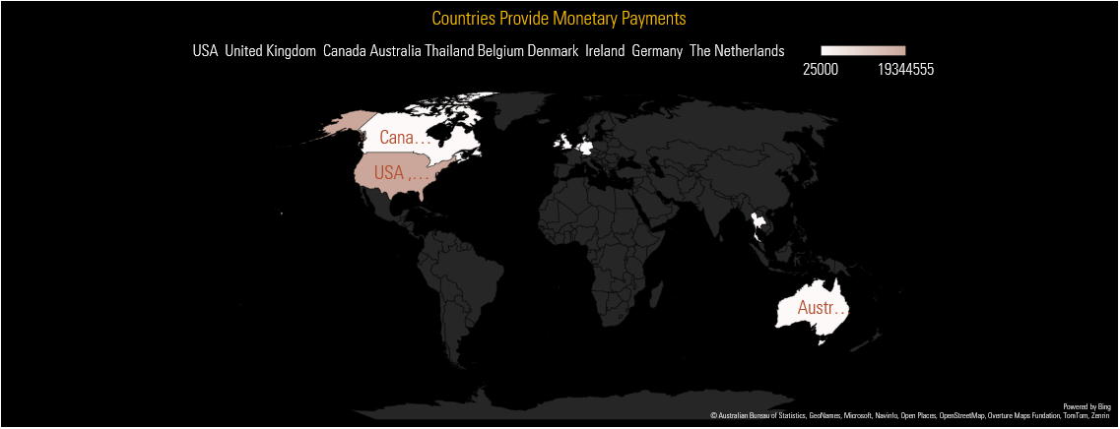
Countries with High Bonus

Slide 7
Gender Distribution

Slide 8
Managemant Seniority

Slide 9
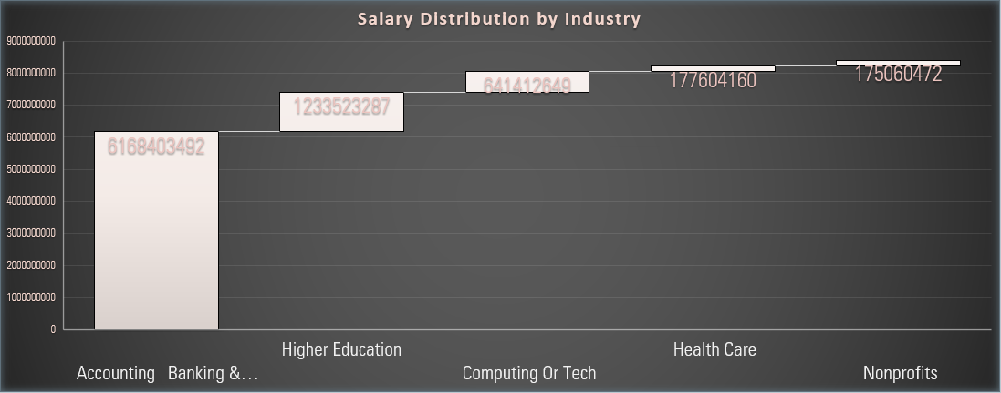
Salary Distribution

Slide 10
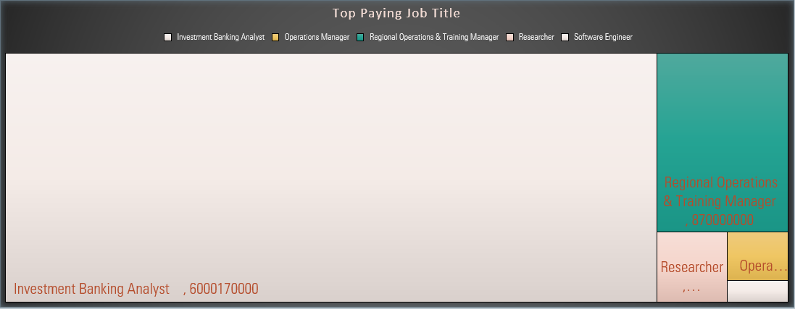
Top Paying Job Title

Slide 11
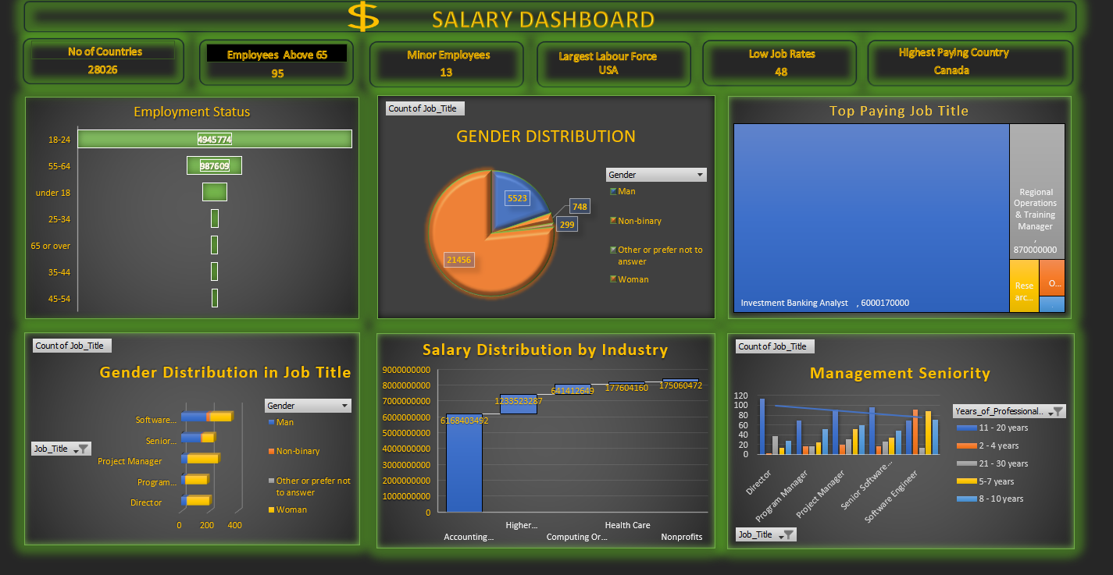

Slide 12





Insights
USA and Canada dominate in terms of salary levels, with industries like investment banking and software engineering paying some of the highest wages.
There is a gender disparity in the dataset, with far more women than men represented.
High-paying roles such as investment banking analysts and senior software engineers appear consistently at the top of the salary rankings.
Employee bonuses are significant in the USA, UK, and Canada, contributing to the overall high compensation levels in these countries.
The age distribution suggests that very few employees under the age of 18 are included in the workforce, which aligns with labor regulations that limit youth employment.

Slide 13
Areas of focus
Global Salary Discrepancies
Companies could explore ways to provide competitive salaries in emerging economies to attract top talent.
Focus on upskilling and reskilling programs to prepare employees for future job market demands, especially in technology and finance.
Create Opportunities
Flexible Work Options for Older Employees (above 65) to encourage continued employment and knowledge sharing.
Youth Employment Opportunities, focusing on internships or apprenticeships to boost employment for those under 18

Slide 14

Thank you

